Slide 1
Chapter 2: Computer-System Structures
Computer System Operation
I/O Structure
Storage Structure
Storage Hierarchy
Hardware Protection
General System Architecture

Slide 2
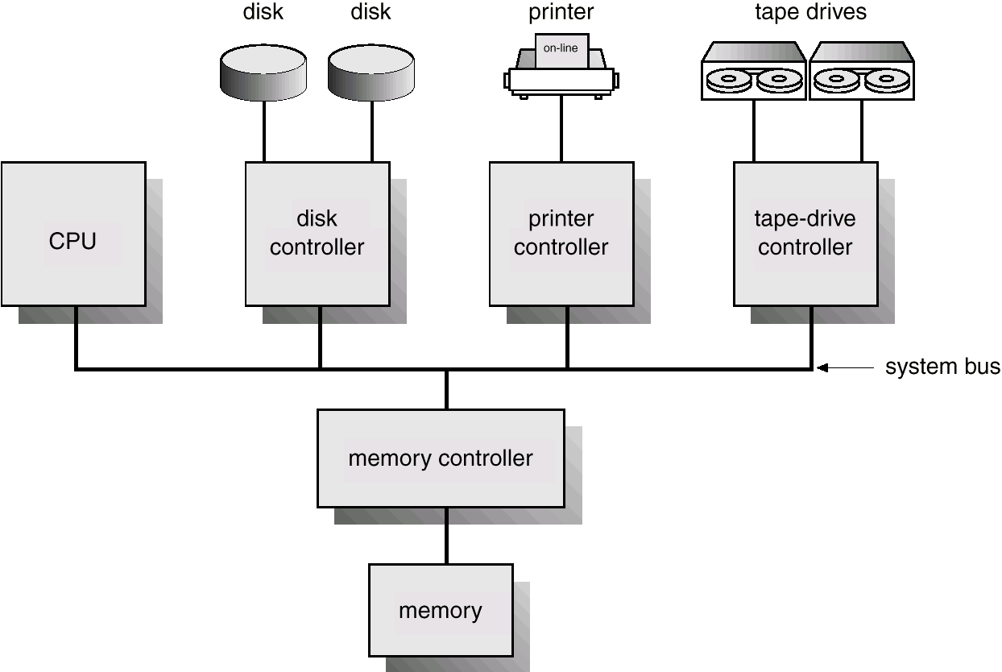
Computer-System Architecture

Slide 3
Computer-System Operation
I/O devices and the CPU can execute concurrently.
Each device controller is in charge of a particular device type.
Each device controller has a local buffer.
CPU moves data from/to main memory to/from local buffers
I/O is from the device to local buffer of controller.
Device controller informs CPU that it has finished its operation by causing an interrupt.

Slide 4
Common Functions of Interrupts
Interrupt transfers control to the interrupt service routine generally, through the interrupt vector, which contains the addresses of all the service routines.
Interrupt architecture must save the address of the interrupted instruction.
Incoming interrupts are disabled while another interrupt is being processed to prevent a lost interrupt.
A trap is a software-generated interrupt caused either by an error or a user request.
An operating system is interrupt driven.

Slide 5
Interrupt Handling
The operating system preserves the state of the CPU by storing registers and the program counter.
Determines which type of interrupt has occurred:
  polling
  vectored interrupt system
Separate segments of code determine what action should be taken for each type of interrupt

Slide 6
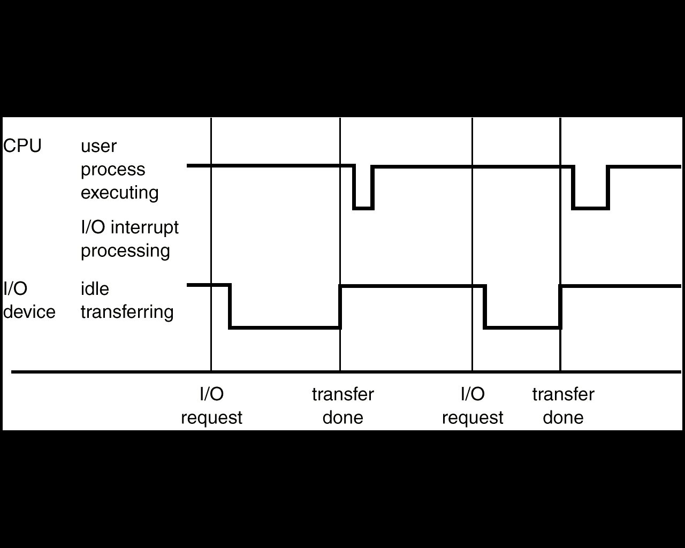
Interrupt Time Line For a Single Process Doing Output

Slide 7
I/O Structure
After I/O starts, control returns to user program only upon I/O completion.
  Wait instruction idles the CPU until the next interrupt
  Wait loop (contention for memory access).
  At most one I/O request is outstanding at a time, no simultaneous I/O processing.
After I/O starts, control returns to user program without waiting for I/O completion.
  System call – request to the operating system to allow user to wait for I/O completion.
  Device-status table contains entry for each I/O device indicating its type, address, and state.
  Operating system indexes into I/O device table to determine device status and to modify table entry to include interrupt.

Slide 8
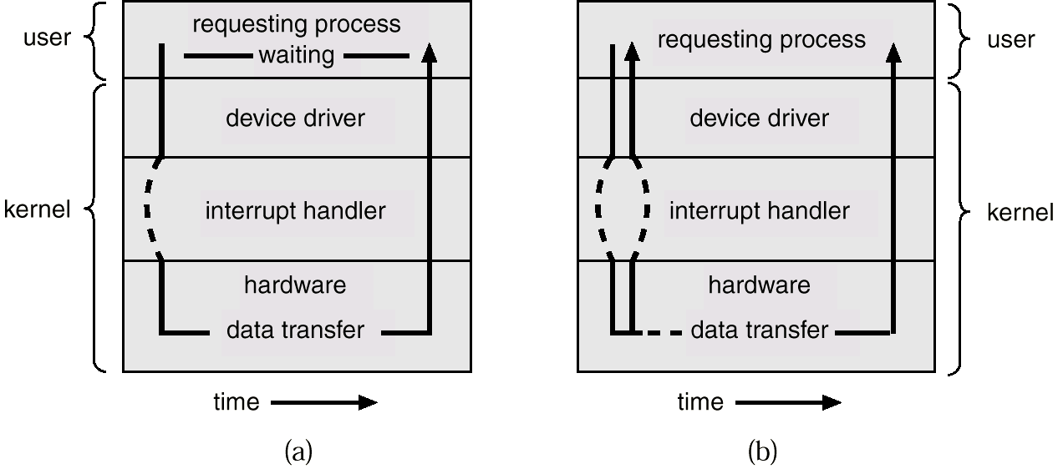
Two I/O Methods
Synchronous
Asynchronous

Slide 9
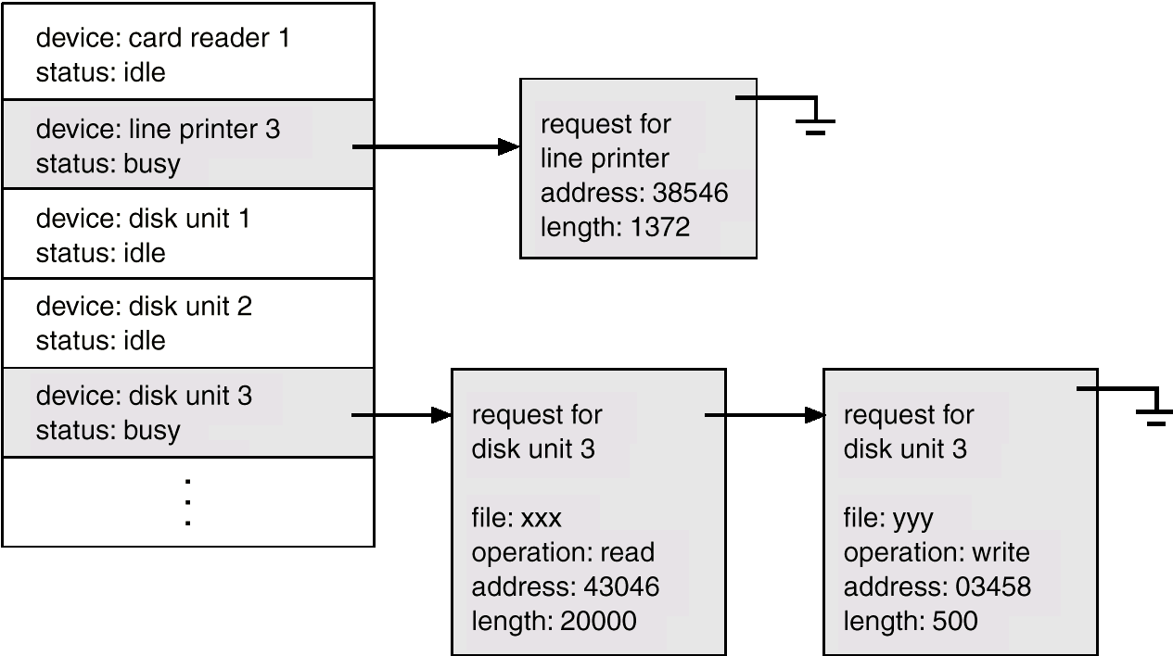
Device-Status Table

Slide 10
Direct Memory Access Structure
Used for high-speed I/O devices able to transmit information at close to memory speeds.
Device controller transfers blocks of data from buffer storage directly to main memory without CPU intervention.
Only on interrupt is generated per block, rather than the one interrupt per byte.

Slide 11
Storage Structure
Main memory – only large storage media that the CPU can access directly.
Secondary storage – extension of main memory that provides large nonvolatile storage capacity.
Magnetic disks – rigid metal or glass platters covered with magnetic recording material
  Disk surface is logically divided into tracks, which are subdivided into sectors.
  The disk controller determines the logical interaction between the device and the computer.

Slide 12
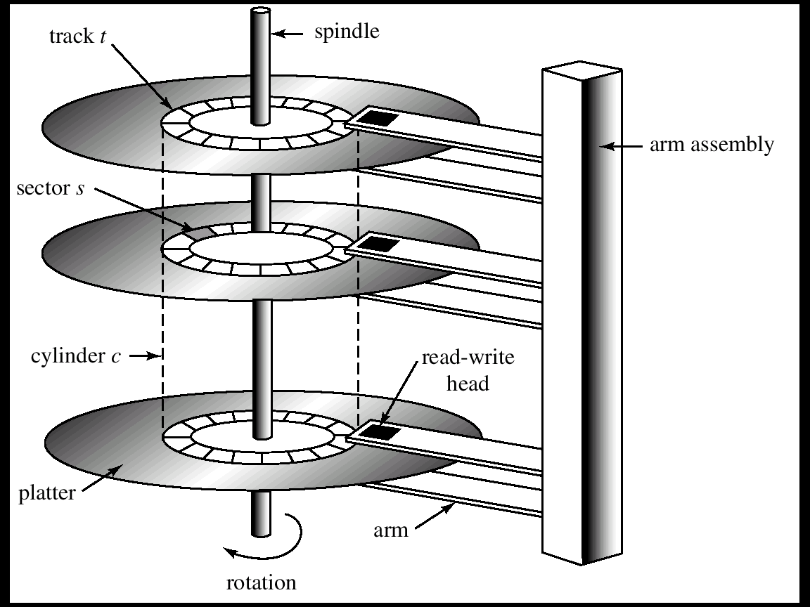
Moving-Head Disk Mechanism

Slide 13
Storage Hierarchy
Storage systems organized in hierarchy.
  Speed
  Cost
  Volatility
Caching – copying information into faster storage system; main memory can be viewed as a last cache for secondary storage.

Slide 14
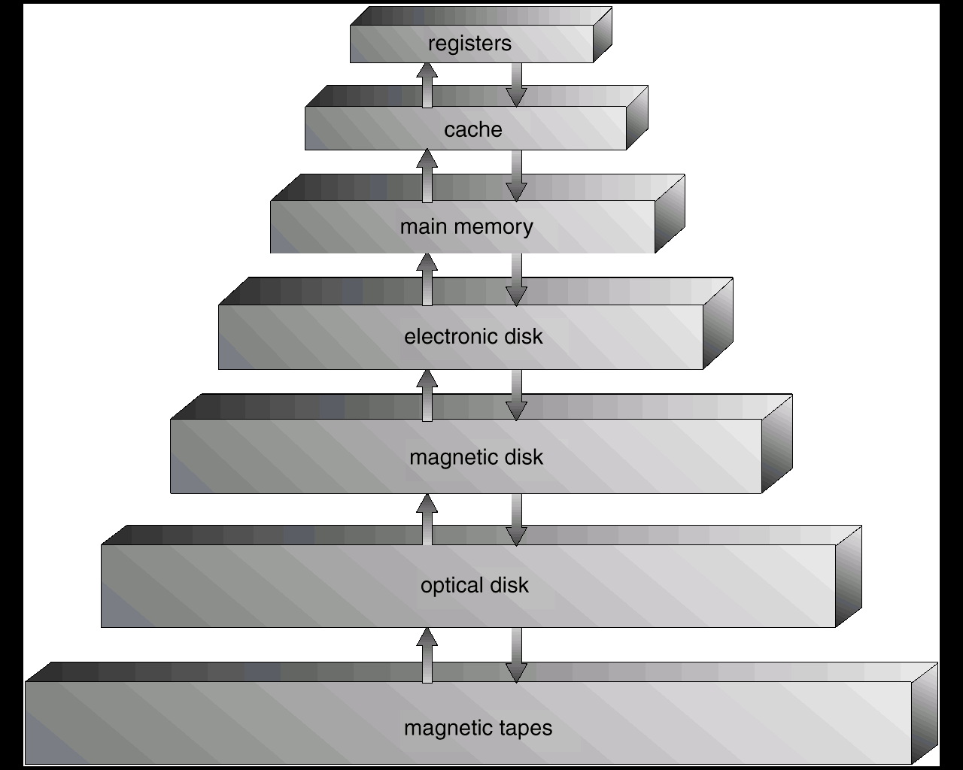
Storage-Device Hierarchy

Slide 15
Caching
Use of high-speed memory to hold recently-accessed data.
Requires a cache management policy.
Caching introduces another level in storage hierarchy. This requires data that is simultaneously stored in more than one level to be consistent.

Slide 16
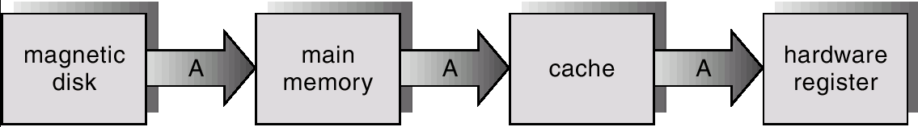
Migration of A From Disk to Register

Slide 17
Hardware Protection
Dual-Mode Operation
I/O Protection
Memory Protection
CPU Protection

Slide 18
Dual-Mode Operation
Sharing system resources requires operating system to ensure that an incorrect program cannot cause other programs to execute incorrectly.
Provide hardware support to differentiate between at least two modes of operations.
  1. User mode – execution done on behalf of a user.
  2. Monitor mode (also kernel mode or system mode) – execution done on behalf of operating system.

Slide 19
Dual-Mode Operation (Cont.)
Mode bit added to computer hardware to indicate the current mode: monitor (0) or user (1).
When an interrupt or fault occurs hardware switches to monitor mode.
Interrupt/fault
monitor
user
set user mode
Privileged instructions can be issued only in monitor mode.

Slide 20
I/O Protection
All I/O instructions are privileged instructions.
Must ensure that a user program could never gain control of the computer in monitor mode (I.e., a user program that, as part of its execution, stores a new address in the interrupt vector).

Slide 21
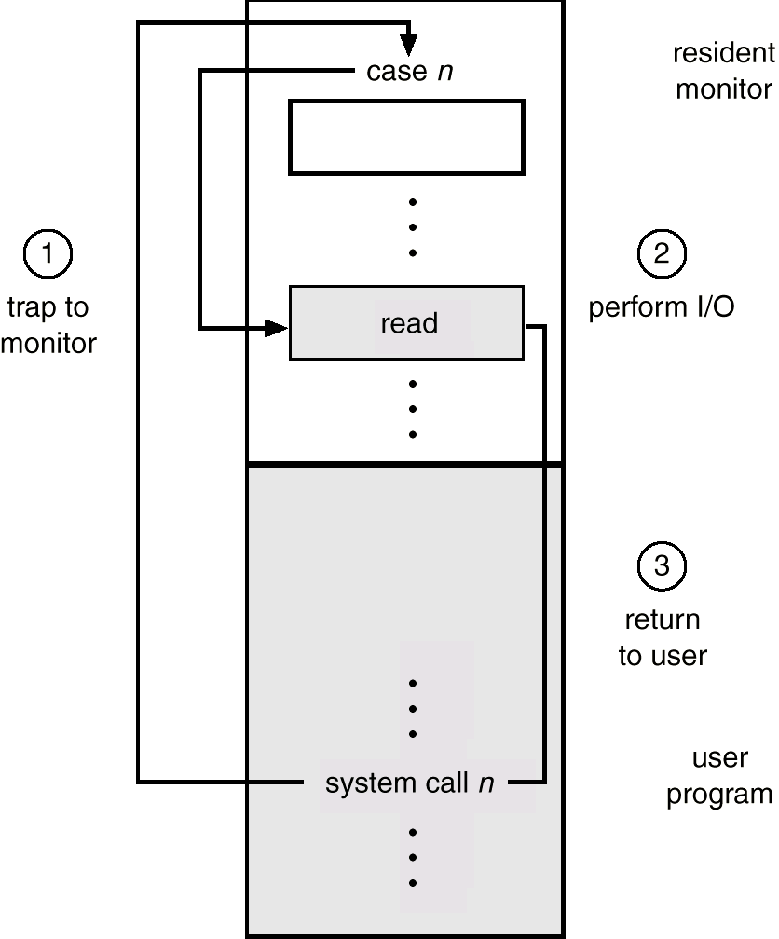
Use of A System Call to Perform I/O

Slide 22
Memory Protection
Must provide memory protection at least for the interrupt vector and the interrupt service routines.
In order to have memory protection, add two registers that determine the range of legal addresses a program may access:
  Base register – holds the smallest legal physical memory address.
  Limit register – contains the size of the range
Memory outside the defined range is protected.

Slide 23
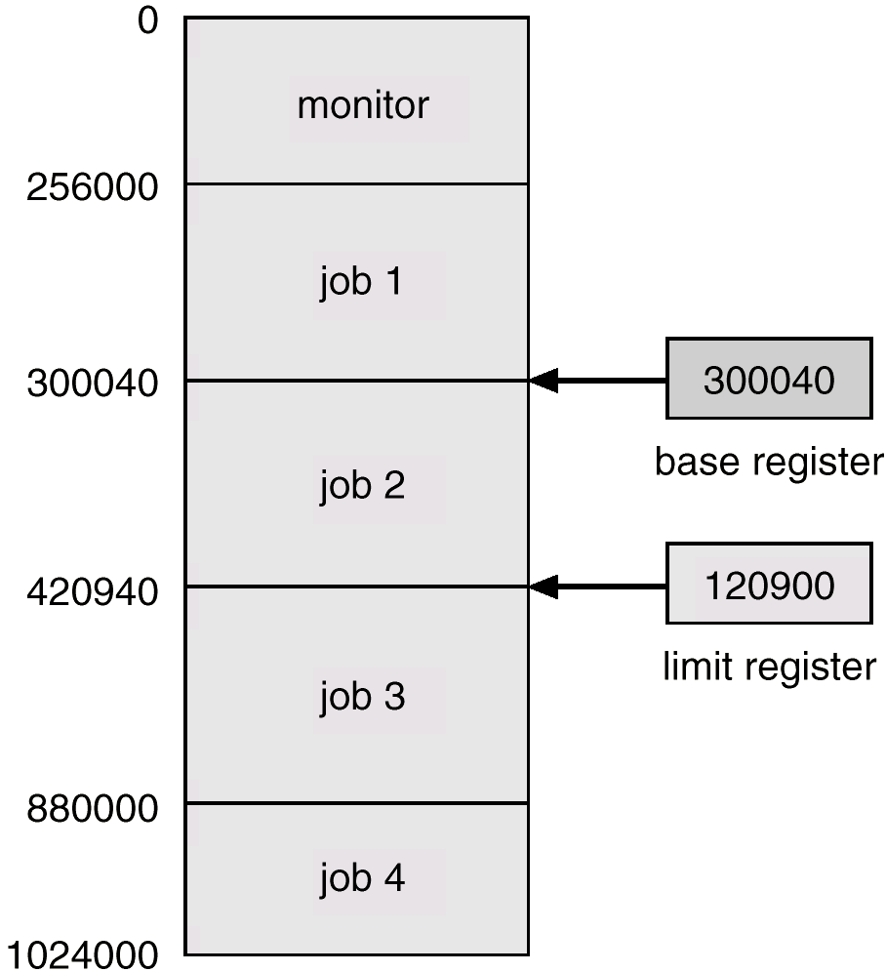
Use of A Base and Limit Register

Slide 24
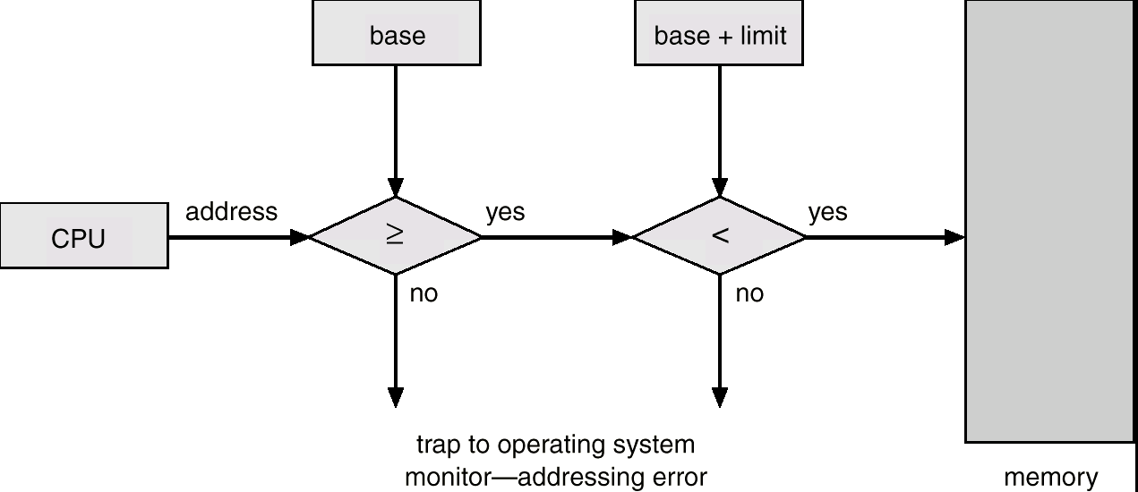
Hardware Address Protection

Slide 25
Hardware Protection
When executing in monitor mode, the operating system has unrestricted access to both monitor and user’s memory.
The load instructions for the base and limit registers are privileged instructions.

Slide 26
CPU Protection
Timer – interrupts computer after specified period to ensure operating system maintains control.
  Timer is decremented every clock tick.
  When timer reaches the value 0, an interrupt occurs.
Timer commonly used to implement time sharing.
Time also used to compute the current time.
Load-timer is a privileged instruction.

Slide 27
Network Structure
Local Area Networks (LAN)
Wide Area Networks (WAN)

Slide 28
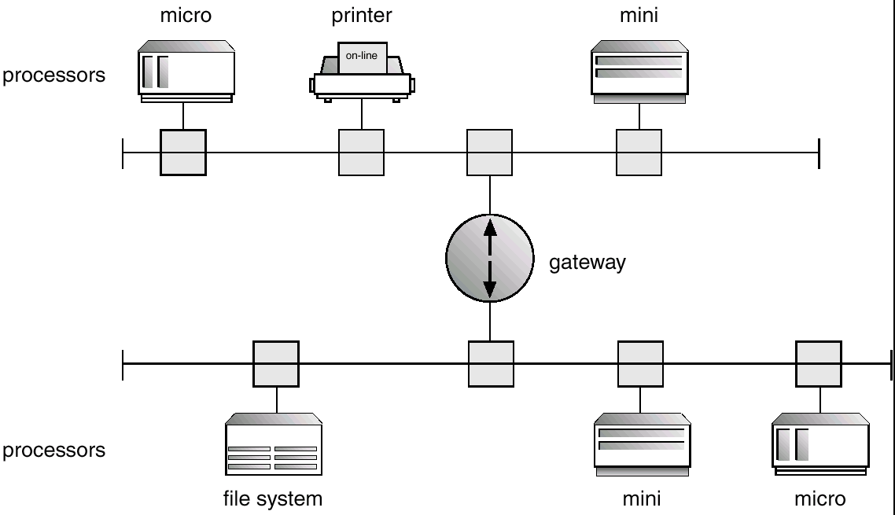
Local Area Network Structure

Slide 29
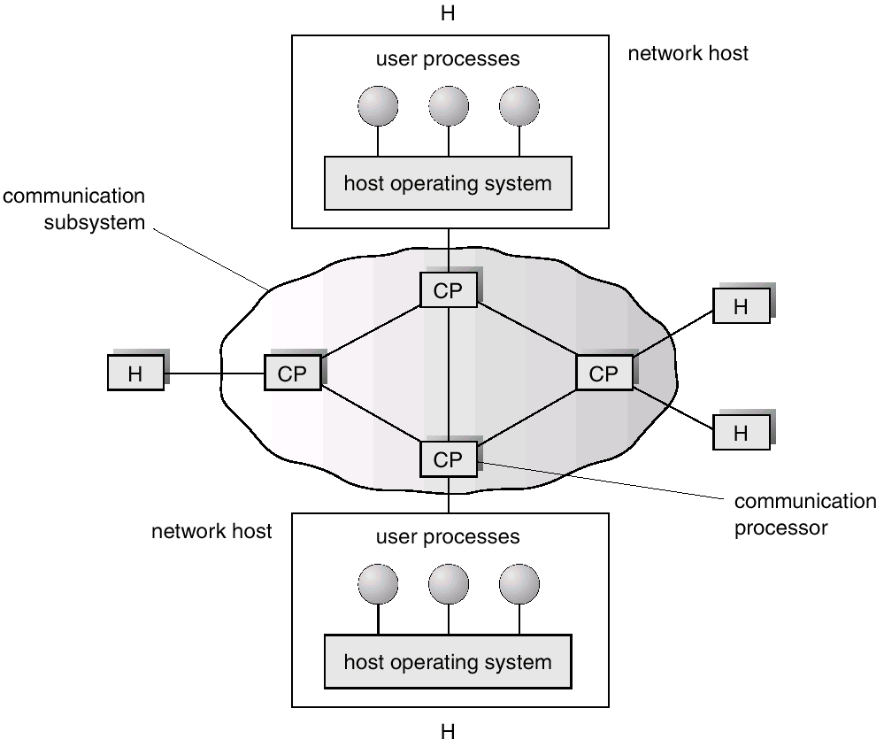
Wide Area Network Structure

